Slide 1
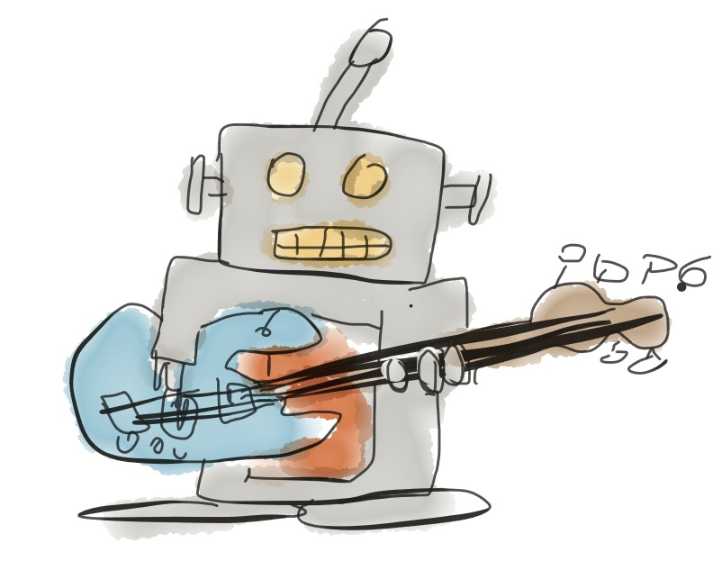
JamBot
Tal Baumel, Eyal Gruss, Yossi Adi

Slide 2
What is JamBot?
We wanted to create an AI to play along with unskilled musicians
Since we didn't have any formal musical education, we didn’t want JamBot to have either
=
+

Slide 3
The Dataset
We didn’t want to use boring public domain MIDI datasets
We used a collection of 50,000 Guitar Pro files
Guitar Pro files contain tablature for pop/rock songs
We created guitar\bass track pairs (assuming bassists are unskilled musicians)
Tried to model “reaction” of a guitarist to a bass track

Slide 5
Pre-processing
We didn’t use the entire range of the bass/guitar, we limited it to one octave; and normalized to C scale
We used BIO tags for nodes
Timing is hard, we ended up using absolute timing

Slide 6
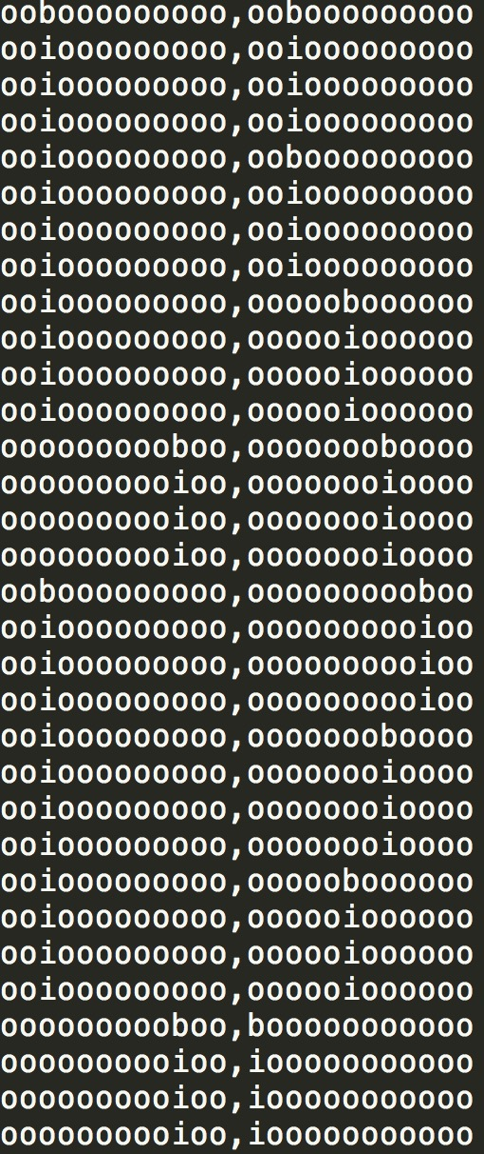
Pre-processing
Time->
Input Example:
Bass ->
<- Guitar

Slide 7
Pre-processing
Demo of a parsed song from the dataset

Slide 8
The model
Basically a standard LSTM language model (KERAS)
State_{t-1}
128 Dim Vector
Bass
Guitar
Embeddings
LSTM Cell
MLP
String
12 Dim Vector
12 Dim Vector
String
128 Dim Vector
State_{t}

Slide 9
Real-Time Playing
MIDI Keyboard
Parsing
Prediction
MIDI
Logic

Slide 10
Demos
Playing along to “Blitzkrieg Bop-The Ramones” from the dataset: https://soundcloud.com/tal-baumel/jambot-feat-the-ramones
Playing along to me: https://soundcloud.com/tal-baumel/jambot-seperated-instruments https://soundcloud.com/tal-baumel/jambot

Slide 11
Future Work
More training
Better model
Better pre-processing
Learn how to use MIDI for better recording
Better data collection
Exploit other instruments (vocals)
Exploit meta-data

Slide 12
Disclaimer!
JamBot is an experiment
Last time we updated the project was ~year ago
We would love to get some help getting the project up again

Slide 13
Thank You

